Slide 1
Add Users and Manage Permissions with Liferay DXP
Liferay DXP Basics
Business
Liferay DXP 7.4

Slide 2
Key Module Takeaways
Users can be created or imported from existing databases
Users can be organized into hierarchical structures and individual groups
Permissions are actions on resources and can be assigned to Users through Roles
Roles exist in three scopes: Regular, Organization, and Site

Slide 3
Exercise Prerequisites (1/2)
Unzipped module exercise files in the following folder structure:
Windows: C:\liferay
Unix Systems: [user-home]/liferay
Liferay DXP 7.4 set up and running
If you have not started your Liferay instance yet, set it up with the following basic configuration:
Portal Name: Mondego
First Name: Test
Last Name: Test
Email: test@modego.com

Slide 4
Exercise Prerequisites (2/2)
Uncheck Require strangers to verify their email address in the User Authentication section of the Control Panel under Instance Settings
Check out the Liferay Foundations: Introduction to Liferay DXP course if you have questions on starting a new instance of Liferay DXP

Slide 5
Intro to Use Case: The Mondego Group
The Mondego Group needs User structures that represent:
Subsidiaries
Department Structures
Customer and Investor Groups

Slide 6

Intro to Use Case: The Mondego Group
Mondego also needs to control User access for actions on the platform, including:
Organization of User Accounts into Organizations and User Groups
Creation of Mondego Sites
Platform Configuration

Slide 7


Relevant KPIs
Increase the number of Users on the platform
Improve the organizational structures of platform Users
Improve User autonomy through the assignment of Roles
Reduce User permissions to only include those relevant to the User’s position

Slide 8
Adding Users to Liferay DXP

Slide 9
Adding Users to the Platform
There are several ways to add Users to the platform in Liferay DXP:
Create new Users from the Administrator account
Allow Users to register themselves
Sync Users from an LDAP server
Notes:
Notes:
Keep in mind, in Liferay DXP, Users fall into three categories: Administrator (full system access), Guest (unauthenticated users), and User (authenticated users with membership access).
Administrators have the ability to add Users from the Control Panel or through the REST API.
We will go over the process of adding Users from the Control Panel in the Exercise: Create New Users.
By default, Guests can create User accounts. To manage User registration and authentication, adjust User Authentication settings in the Control Panel under Instance Settings.
Organizations that manage Users with LDAP can sync the LDAP server with Liferay to import Users. We will discuss importing and authenticating Users on the next slides.
Use Case:
The Mondego Group can use all three of these methods to add Users. Existing Users can be imported from an LDAP server. Certain new Users, like employees, need to be created by the Administrator while others, such as customers, can register for an account themselves.

Slide 10
Importing and Authenticating Users
In Liferay, there are two primary methods for importing and authenticating outside Users:
Importing Users from an LDAP server
Using Single-sign on, OAuth 2, and SAML authentication options
Notes:
Notes:
Here, you can talk about the different kinds of users that businesses will need on the platform:
Employees
Customers
Business Partners
Contractors
Use Case:
The Mondego Group has an LDAP server currently storing existing Users, including its employees and some existing customers. This data can be imported to the Liferay instance as well as exported from Liferay to an LDAP server as needed. Additionally, because Mondego needs to register and authenticate new customer accounts, it can set up Single-sign on or other authentication option. For certain parts of the Mondego company, it may be preferable to use Multifactor Authentication; this will be discussed in a separate module.
You can also discuss different kinds of data included with Users in an authentication server. If you have experience with User management, this is a great place to give an example story.

Slide 11
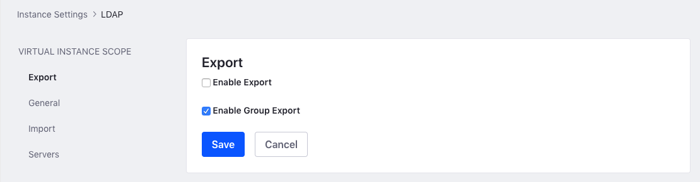
LDAP Mapping
Liferay integrates with LDAP and allows administrators to keep the systems in sync by:
Determining what data needs to be imported from the LDAP server
Determining what data needs to be exported back to the LDAP server
Notes:
Notes:
Some highlights to keep in mind when it comes to LDAP Mapping include the option to:
Enable Import from LDAP
Import or Autogenerate Password
Import individual Users or Groups
Create a Role per Group on Import
Enable Export from Liferay to the authentication system
Enable Group Export from Liferay to the authentication system
Use LDAP Password Policy in Liferay

Slide 12
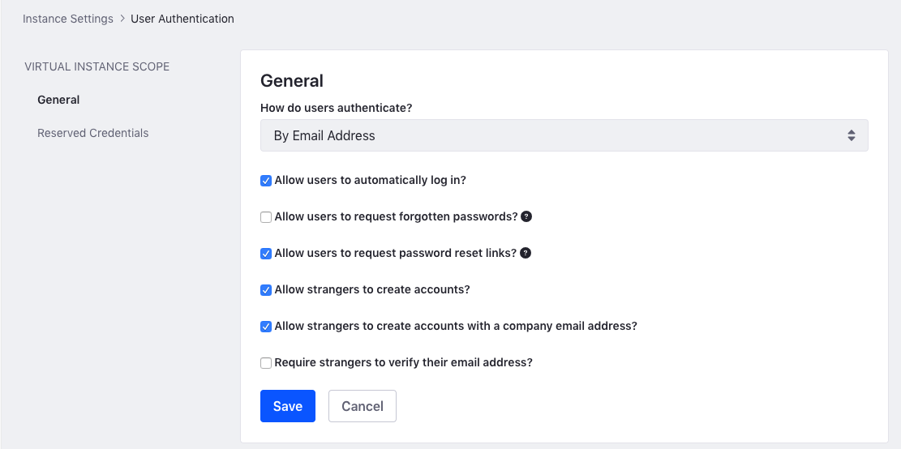
Liferay DXP Authentication
The general Liferay DXP authentication settings can be configured to control:
User authentication protocols
User password protocols
Account creation/verification protocols
Notes:
Notes:
To configure the authentication settings, go to Control Panel → Configuration → Instance Settings → User Authentication. Under General, you can find settings to configure:
How users authenticate
How to manage user passwords
Who can create accounts
How accounts are verified
Note: In order to complete exercises, you will need to deselect “Require strangers to verify their email addresses” since we will not have a mail server set up.
Use Case:
Depending on the Site, Mondego may disallow strangers to create accounts. For instance, where an internal company Site requires that a User have a company email address, a public facing Site may allow anyone to sign up for an account.

Slide 13
OAuth2 and SAML
By default, Liferay uses the Sign In widget to authenticate Users
Other forms of authentication with Liferay DXP include:
OAuth 2.0
SSO Configuration:
Multi-factor Authentication
SAML
Facebook Connect
OpenID Connect
OpenSSO
Token Based SSO
Notes:
Notes:
OAuth 2.0 authorizes users to access certain data by enabling an application to access another application’s data without revealing a user’s credentials. For example, when someone signs into a website using Facebook, Google, or another account.
In Liferay, Single Sing-On must be enabled before it can be used. There are several SSO methods that can be configured for authenticating users or applications, including Token-Based SSO, SAML, and OpenSSO.
Multi-factor Authentication requires that users prove their identity in multiple ways (or factors), which may be a priority when it comes to sensitive information or content on a Site.
Liferay DXP takes a “secure by default” philosophy. Take caution when modifying security-specific defaults to avoid misconfiguration or an insecure deployment. For more information on User authentication, security, etc., see the “Secure Your Liferay DXP Platform” module or Securing Liferay documentation.
Use Case:
Mondego may opt to use a different kind of authentication depending on the particular needs of its Sites. For any of its sites that handle sensitive information, such as its banking site, Mondego might opt for a more rigorous authentication form, such as multifactor authentication.

Slide 14
Use Case Example: Authenticating Mondego Users
The Mondego Group can add Users in a variety of ways including:
Importing Users from its existing LDAP server and maintaining the data on that server as needed
Creating new Users from the Administrator account, useful whenever new employees are added to the platform
Allowing Users to register and create their own accounts, ideal for Mondego’s banking and investment sites
Mondego also has several options for authenticating users, including SSO, SAML, and Multifactor Authentication

Slide 15
Knowledge Check
The Mondego Group needs its platform to include several kinds of users, including employees, partners, and customers. It can do this by:
Importing existing users from an LDAP server
Creating new Users using the Administrator account
Enabling Open Registration and setting Authentication options
Authentication options available to Mondego with Liferay DXP include SSO, OAuth2, and Multi-factor authentication.
Mondego Administrators can keep Liferay and their LDAP in sync by establishing what data needs to be imported and exported.

Slide 16
Knowledge Check
The Mondego Group needs its platform to include several kinds of users, including employees, partners, and customers. It can do this by:
Importing existing users from an LDAP server
Creating new Users using the Administrator account
Enabling Open Registration and setting Authentication options
Authentication options available to Mondego with Liferay DXP include SSO, OAuth2, and Multi-factor authentication.
Mondego Administrators can keep Liferay and their LDAP in sync by establishing what data needs to be imported and exported.

Slide 17
Exercise: Create New Users

Slide 18
Create New Users Exercise Objectives
Create a new platform administrator
Create two new Users while signed in as the new administrator
Give the new Users passwords and access to the Mondego Group Site

Slide 19

Create New Users Exercise Steps (1/3)
Create a new platform administrator, Elliot Quinn
Give Elliot a Password
Make Elliot an Administrator
Sign in as Elliot Quinn

Slide 20
Create New Users Exercise Steps (2/3)
Create the User Naomi Engel
Give Naomi a Password
Give Naomi Access to the Mondego Group Site

Slide 21
Create New Users Exercise Steps (3/3)
Create the User Ayokunle Idowu
Give Ayokunle a Password
Give Ayokunle Access to the Mondego Group Site

Slide 22
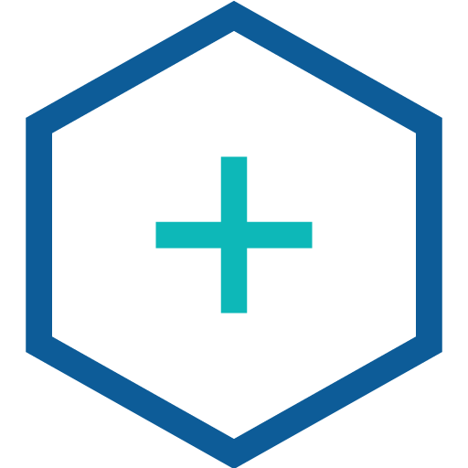
Create New Users Bonus Exercises
Create a new User, Bethany Park. Give Bethany a password, access to the Mondego Group Site, and the phone number (314) 157-2757 as Contact Information.

Slide 23
Manage and Organize Users

Slide 24
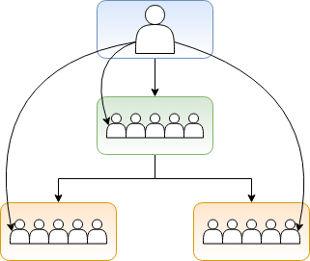
Hierarchical Organizations in Liferay DXP
Organizations give you the ability to organize Users hierarchically according to the structure of real-world groups and companies
Organization Administrators can manage all the Users in their organization as well as all of its Sub-Organizations
Notes:
Notes:
The key point is that Organizations are purely about organizing Users in a hierarchy. This is a distinct concept from Sites and Site hierarchies (which will be discussed more in another module) where pages and content are managed.
Users can be in multiple Organizations as needed.
Use Case:
For the Mondego Group, Organizations can be used to organize its subsidiaries, branches, departments, and even customers. For instance, the subsidiary, Mondego Investments, can organize its departments and regional offices hierarchically using the Organizations feature.

Slide 25
Organization Sites
Organization Sites are Sites that can be created in conjunction with an Organization. This means:
Organization Administrators become the Site administrator
Members of the Organization become members of the Site
Notes:
Notes:
Organization Sites are not required for an Organization to exist in Liferay DXP. Depending on the nature of the Organization, some may not need a distinct Organization Site.
Use Case:
Because each subsidiary within the Mondego Group has its own internal structure and departments, creating Organization Sites allows the subsidiaries to organize content specific to each Organization and Sub-Organization. Mondego Investments, for example, can create distinct Sites for each department or team.

Slide 26
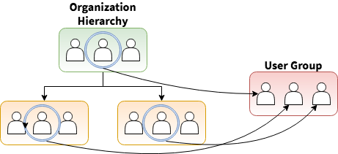
User Groups in Liferay DXP
User Groups are logical groupings of Users that traverse the Organizational structure
There are two primary ways to create User Groups on the platform:
User Groups are created by default when an LDAP group is imported
User Groups can be manually created to intentionally create new groupings for a specific purpose
Notes:
Notes:
User Groups are created for a specific purpose and are not bound by the hierarchy of Organizations. A few common use cases for User Groups include:
Managing Site membership by assigning membership to an entire User Group
Managing the personal pages of Users in the group
Collecting permissions and assigning Roles to an entire group rather than individuals
Use Case:
Since User Groups are not bound to the hierarchical structure, they can be useful for creating groups of users who are responsible for a specific purpose, regardless of their location within the hierarchy. For instance, Mondego Banks offers various reward levels for credit cards and needs to group Users together by those rewards . Once formed, the User Groups can be given membership, page access, or resource permissions regardless of the department, position, or status of the User in the larger organization hierarchy.

Slide 27
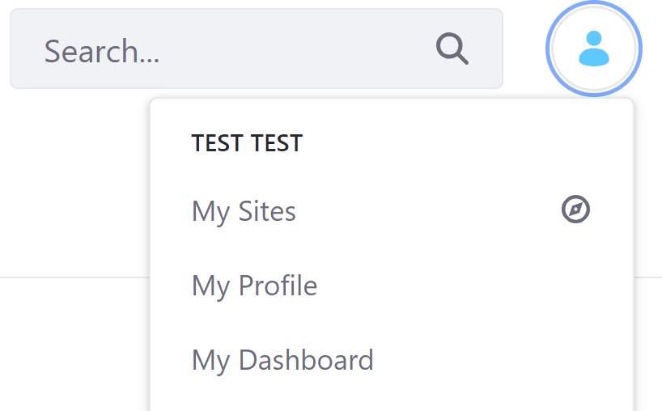
User Group Sites
By default, Users have a Profile and Dashboard
A User Group Site is a template of pages that is added to the Profile or Dashboard of every User Group member
Notes:
Notes:
Unlike Organization Sites which can be created in conjunction with the Organization, User Group Sites don’t appear as a separate Site that Users access but rather as Pages on individual Users’ Dashboards.
These pages are dynamic and show with any other pages a User has on their personal Site.
Users cannot modify Pages inherited from the User Group.
Use Case:
For Mondego, a User Group Site could be created for different credit card tiers and levels. For example, a Silver credit card holder assigned to that User Group will have pages relevant to that Site show up on their personal Site/User Dashboard.

Slide 28
Use Case Example: Mondego Organizations
Mondego Investments needs to organize its Users, so it creates Organizations to reflect the departments, including Advisors, Marketing, and Human Resources.
Suborganizations, such as Sales and Events, are created under the Marketing Organization
A Marketing Organization Site is also created to allow Users to view content specific to that Organization
To organize Users for one of the rewards programs, Mondego can create User Groups for the different reward levels
A User Group for Platinum Card holders can also have a User Group Site, which adds a template of pages to each User’s Dashboard

Slide 29
Knowledge Check
To reflect the hierarchical structure of its company and its subsidiaries, Mondego can use Organizations.
Mondego’s Human Resources department can create an Organization Site to manage relevant content.
User Groups can be created to manage Mondego Users that share a similar purpose but belong to different subsidiaries or departments.
To make sure these Users can find relevant pages on their Profile or Dashboard, a User Group Site can be added.

Slide 30
Knowledge Check
To reflect the hierarchical structure of its company and its subsidiaries, Mondego can use Organizations.
Mondego’s Human Resources department can create an Organization Site to manage relevant content.
User Groups can be created to manage Mondego Users that share a similar purpose but belong to different subsidiaries or departments.
To make sure these Users can find relevant pages on their Profile or Dashboard, a User Group Site can be added.

Slide 31
Exercise: Create an Organization Hierarchy

Slide 32
Create an Organization Hierarchy Exercise Objectives
Create a Basic Mondego Organization Hierarchy
Create Mondego Organization Sites
Assign a Mondego User to a Mondego Organization

Slide 33
Create an Organization Hierarchy Exercise Steps
Create a New Mondego Investments Organization
Create a Sub-Organization for Investment Marketing
Create an Organization Site for Investment Marketing
Create a Sub-Organization for Investment Advisors
Create an Organization Site for Investment Advisors
Assign Naomi Engel to the Investment Marketing Organization

Slide 34
Create Sub-Organizations Bonus Exercise
Create Sub-Organizations under Investment Marketing for Sales, Design, and Events. Add appropriate tags for each sub-organization. Assign Bethany Park to the Sales Organization.

Slide 35
Exercise: Create and Manage User Groups

Slide 36
Create and Manage a User Group Exercise Objectives
Create three User Groups for the Mondego Credit Card Tiers
Assign a User to one of the new User Groups
Create a User Group Site

Slide 37
Create and Manage a User Group Exercise Steps
Create the Mondego Silver Cards User Group
Create the Mondego Gold Cards User Group
Create the Mondego Platinum Cards User Group
Assign Naomi Engel to the Mondego Platinum Cards User Group
Create a Mondego Platinum Cards Private User Group Site
Add Fragments and Widgets to the Account Overview Page
Configure the Fragments on the Account Overview Page

Slide 38
Create and Manage a User Group Bonus Exercises
Create Private Account Overview Pages for the Mondego Gold and Silver Cards User Group Sites using different fragments and widgets than the Mondego Platinum Cards Page. Add Ayokunle Idowu to the Mondego Gold Cards User Group. Sign in as Ayokunle to confirm access to the Account Overview page.

Slide 39
Roles and Permissions

Slide 40
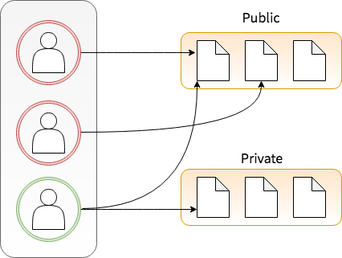
Controlling Access
Administrators will need to control access to the following:
Platform access
Site access
Page access
Asset access
Notes:
Notes:
As you may recall, the Administrator account is created by default in any new installation of Liferay DXP. The Administrator has full permissions to modify every facet of the instance.
As the default Administrator, you can create a new admin account by either creating a new User or assigning an existing User to the Administrator Role under Regular Roles (more on Regular Roles to come).
Use Case:
Mondego’s main platform Administrator will need to create or assign additional Administrators once the instance is up and running to distribute the workload. Since different Sites and Organizations may have different workplans, an Admin for each level is essential.

Slide 41
Liferay DXP’s Fine-Grained Permissions
Permissions are actions that can be taken on platform resources, including things like:
Adding content
Editing content
Viewing content
Uploading images
Creating pages
Notes:
Notes:
Permissions can also be scoped:
Application Scoped Permissions are permissions granted on each widget or administrative application
Asset Scoped Permissions are permissions for individual assets, for instance a blog post or document folder.
Use Case:
Permissions are important for ensuring that Users on the Mondego platform can access everything they need without unwittingly changing something. Mondego Customers, for instance, need to be able to manage their account information but they should not be able to change anything on the main Site.

Slide 42
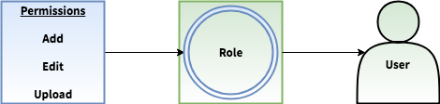
Using Roles to Group and Apply Permissions
Roles are collections of permissions that can be granted to Users
Roles are scoped to the following contexts:
Regular Roles: The Platform level
Organization Roles: The Organization level
Site Roles: The Site level
Asset Library Roles: the Asset Library level
Account Roles: the Account level
Notes:
Notes:
Regular Roles: The permissions for Regular Roles are defined for the platform as a whole. Assigning a Regular Role to a User means they'll have the permissions defined in that role across the entire platform.
Organization Roles: Organization Role permissions that are defined only apply to members of an organization. Assigning an Organization Role to a User means they'll have the permissions defined in that Role for their Organization, Sub-Organizations, and/or Organization Sites.
Site Roles: Permissions for the Site role apply to a specific Site. Assigning a Site Role to a User means they'll have the permissions defined in that Role for specific Sites.
One other Scope exists for Roles: the Asset Library Roles. By default, only Regular, Organization, and Site Roles appear. However, once an Asset Library is added to the instance, you will have the option to create Asset Library Roles.
In order to save time, Roles can be applied to several Users at a time rather than one at time. Roles can also be applied to Sites, Organizations, User Groups, and User Segments.
Account Roles: these are roles assigned for account management
Use Case:
To effectively manage the platform, Sites, and Organizations, the Mondego Group can assign Roles to Users. To manage the entire platform, it establishes a group of Users assigned Regular Roles. For individual Sites, such as the Mondego Investments and Mondego Banking, a Site Administrator manages most the Site needs with the option to assign Site Roles to other Site Members. Additionally, the Marketing department uses Organization Roles to manage its members and Site content.

Slide 43
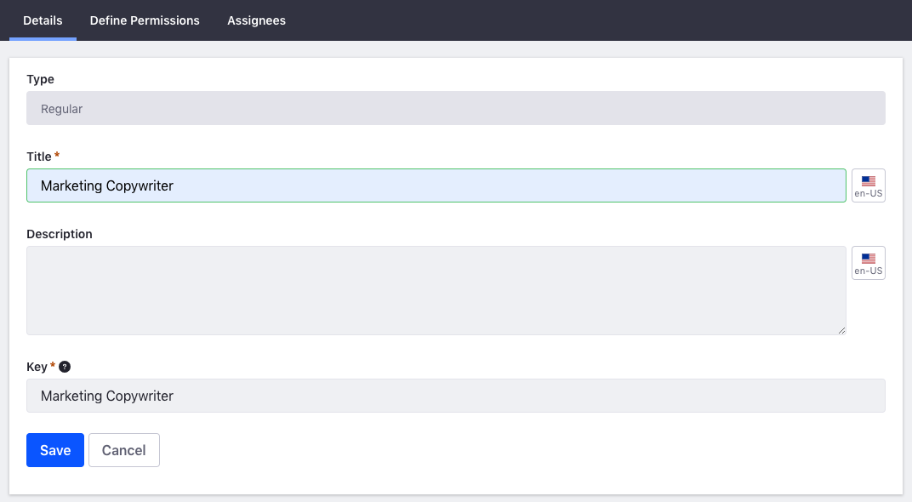
Creating Custom Roles
Administrators can create custom Roles and should consider the following:
What actions and resources are required for the Role?
What Scope will this Role primarily function in?
Create Roles using the principle of least permissions.
Notes:
Notes:
The principle of least permissions is simply a secure principle of making sure people only have the permissions they need to do their job and nothing more, so it's a good principle to follow when creating custom Roles.
Use Case:
The Mondego Group needs several of its managers to be able to access multiple Sites on the Platform. Though at first glance it may be tempting to issue them Regular Roles, the principle of least permissions reminds us that the fewest number of permissions should be granted. In this case, assigning multiple Site Roles would allow the Users to manage their necessary Sites without granting them too much access.

Slide 44
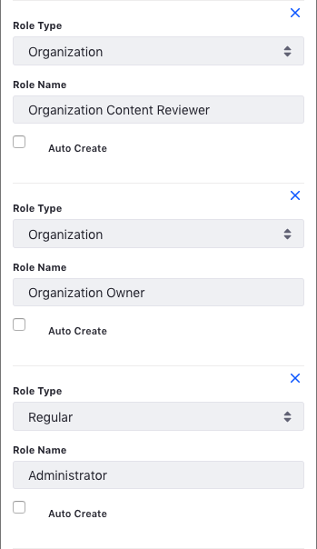
Roles and Workflows
Workflows can be created with actions assigned to specific Roles
If a Role is assigned in a Workflow Definition but does not already exist, the Role will be auto-generated
Notes:
Notes:
The details of Workflow will be covered in a separate Module, so a simple definition will suffice. In general, a Workflow is simply a process to review a resource, like making sure content is copy-edited before it's published. Users with a workflow-designated Role can:
Receive notifications when a workflow process begins
Assign a workflow task to themselves
Provide feedback in the workflow processes (e.g., approving or rejecting)
Use Case:
For the Mondego Group, workflows are a vital part of daily operations. A review workflow could be as simple as sending a document from a creator to a reviewer before publication. In the case of Mondego, much of their content goes through a multistage process. Articles are drafted, sent to copy editors, revised, sent to the legal team for approval, and revised further before anything is published.

Slide 45
Use Case Example: Mondego Roles
The Mondego Investments Site can manage which Users can view, edit, and add content using Liferay’s fine-grained permissions.
To ensure that Users only have the permissions necessary for their job function, Mondego primarily assigns Roles at the Organization or Site level.
Users with Roles in the Mondego Marketing Organization cannot make changes to the main Site and the Banking Site Administrator cannot change the Investments Site
The Mondego Investments team creates a workflow and assigns a task to the Copyeditor Role. Since this is not an existing Site Role, it will be auto-generated.

Slide 46
Knowledge Check
To make sure Mondego Users do not perform unapproved actions on resources, the Administrator can manage and assign Permissions.
Permissions are collected and granted to Mondego Users as Roles, which are scoped at three different levels:
Mondego workflows auto-generate roles if they are assigned but don’t already exist.
Regular
Organization
Site

Slide 47
Knowledge Check
To make sure Mondego Users do not perform unapproved actions on resources, the Administrator can manage and assign Permissions.
Permissions are collected and granted to Mondego Users as Roles, which are scoped at three different levels:
Mondego workflows auto-generate roles if they are assigned but don’t already exist.
Regular
Organization
Site

Slide 48
Exercise: Customize the Site Content Reviewer Role

Slide 49
Customize the Site Content Reviewer Role Exercise Objectives
Modify the Site Content Reviewer Role to include the following:
Edit and View permissions for Web Content
Edit and View permissions for Blogs

Slide 50
Customize Reviewer Role Exercise Steps
View the Default Roles on the Site Roles tab in the Roles section of the Control Panel
Add Web Content Editing and View Permissions
Add Blog Editing and View Permissions

Slide 51
Customize Reviewer Bonus Exercises
Create a new User and make them a member of the main Mondego Site. Grant the new User the Site Content Reviewer role.

Slide 52
Exercise: Create a Custom Site Role

Slide 53
Create a Custom Site Role Exercise Objectives
Create a Site Content Creator Role that allows the web content team to do the following:
Add and Edit Web Content
Add and Edit Blogs
Add and Edit Images

Slide 54
Create a Custom Site Role Exercise Steps (1/3)
Create a new Site Content Creator Role
Add Site Administration Access and View Permissions for Web Content
Add the Add Folder and View Permissions for Web Content
Add the Add Subfolder, Web Content, Update, and View Permissions for Web Content Folders
Add the Update and View Permissions for Web Content Articles

Slide 55
Create a Custom Site Role Exercise Steps (2/3)
Add Site Administration Access and View Permissions for Blogs
Add the Add Entry Permission for All Blog Entries
Add the Add, Delete, Update Discussion, Update, and View Permissions for Blogs

Slide 56
Create a Custom Site Role Exercise Steps (3/3)
Add Site Administration Access and View Permissions for Documents and Media
Add the Add Folder and View Permissions for Documents
Add the Add Subfolder, Document, Update, and View Permissions for Document Folders
Add the Update and View Permissions for Individual Documents

Slide 57
Create a Custom Site Role Bonus Exercises
Create a new User named Corrie Alders. Make Corrie a member of the Mondego Site. Assign Corrie the Site Content Creator role.

Slide 58
Controlling Specific Permissions on Sites

Slide 59
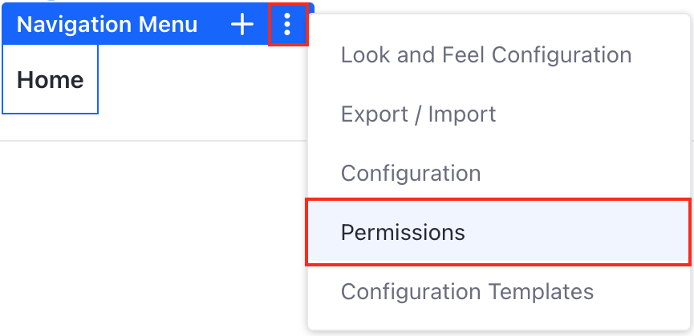
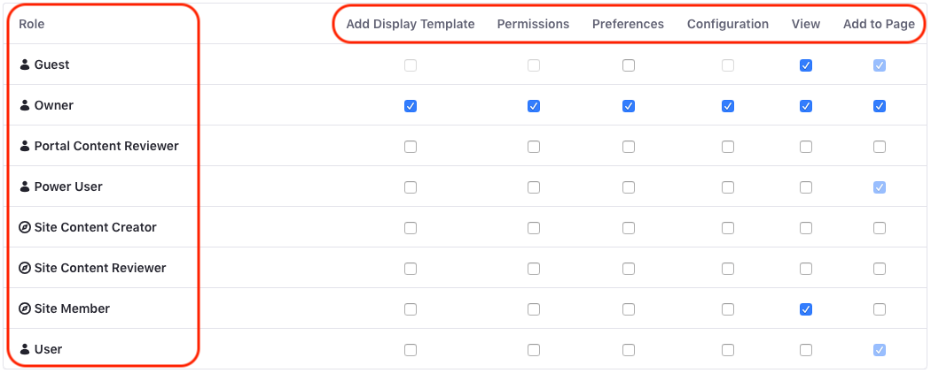
Resource Permissions Menu
Each resource on a Site has an Options menu that includes a Permissions menu
Notes:
Notes:
For Sites or Pages made from Templates and with Inherit Changes switched on, Permissions need to be managed from the Template. For example, widgets on a page created from a template will only show the Export/Import option unless Inherited Changes is switched off.
Use Case:
On the Mondego Investment Site, there are certain resources that are reserved for Site Members. The Site Administrator can remove permissions for Guest Users to view those resources, requiring Users to sign in to access them.

Slide 60
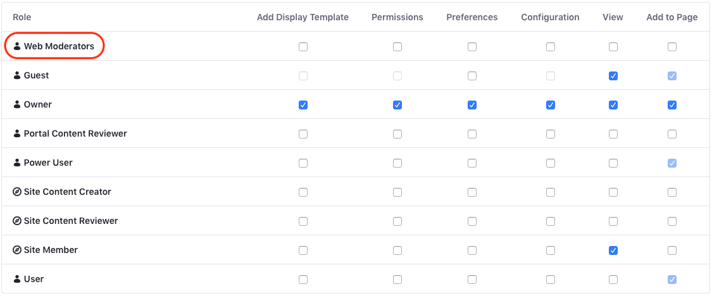
Site Teams
Site Teams are groups of Site Members that can be given additional permissions on specific resources on a Site
Site teams are the preferred method for assigning permissions in a single Site
Notes:
Notes:
Since Site Administrators can’t create Roles, Site Teams allow the Administrator to grant Users permissions on the Site regardless of the Users’ existing Roles.
Site Teams are created and manage from the Site Administration Panel → People → Teams.
Use Case:
For the Mondego Group, Site Teams could be utilized for editing and managing the various blog posts and articles published on a specific regional Site. Since the publications are infrequent, creating an ad hoc group using Site Teams rather than creating a distinct Site Role adheres to the rule of least possible permissions and allows the Site Admin to make changes to Team membership without needing more permissions.

Slide 61
Use Case Example: Mondego Investments Publications
The Mondego Investments Site Administrator can use Site Teams to assign tasks and roles to Users without creating official Site Roles:
The Publications Site Team manages the collecting, writing, reviewing, and publishing of articles on the Site.
Since some of these articles may not be relevant to Guest Users who are simply interested in learning about Mondego Investments, the Site Administrator can use the Permissions Menu to set certain articles and resources to only be viewable by Users or Members, not Guests.

Slide 62
Knowledge Check
Mondego’s Regular, Site, and Organization Administrators can grant or remove a User Role’s permissions on a Site resource in the Permissions Menu.
The Mondego Investments Site Administrator can assign permissions to Users to manage certain resources on the Site using Site Teams.

Slide 63
Knowledge Check
Mondego’s Regular, Site, and Organization Administrators can grant or remove a User Role’s permissions on a Site resource in the Permissions Menu.
The Mondego Investments Site Administrator can assign permissions to Users to manage certain resources on the Site using Site Teams.

Slide 64
Exercise: Manage Teams and Community Permissions

Slide 65
Manage Teams and Community Permissions Exercise Objectives
Create a Site Team for the Mondego Group Site
Modify Permissions on a Resource on the Site

Slide 66
Manage Teams and Community Permissions Exercise Steps
Go to the Mondego Publications Site
Create a Web Moderators Team
Add Ayokunle Idowu to the Mondego Publications Site
Add Ayokunle Idowu to the Web Moderators Site Team
Create a new Community page
Add a Message Boards Widget to the new page
Grant the Web Moderators Team Permissions to the Message Boards Widget

Slide 67
Manage Teams and Community Permissions Bonus Exercises
Grant Bethany Park and Corrie Alders membership to the Mondego Publications Site. Add them to the Web Moderators Team. Sign out of your administrator account and sign in as either Bethany or Corrie.
Create at least one additional User and add them to the Web Moderators Team. Add a new Widget to the Community Page and grant permissions to the team.

Slide 68
Summary (1/2)
Liferay DXP allows platform administrators to create new Users or import existing ones from an LDAP server.
The primary methods of authenticating Users are Single-Sign On, OAuth2, and SAML. Multi-factor authentication can also be configured.
Organizations allow you to organize Users hierarchically and can be associated with Organization Sites.
User Groups are logical groupings of Users that go outside the Organizational structure.

Slide 69
Summary (2/2)
Permissions are actions on resources on the platform.
Roles are collections of permissions that can be assigned to Users.
Roles come in three scopes: Regular (entire platform), Organization (within the context of an organization), and Site (within the context of a Site).
Each resource on the Site has an associated Permissions menu.
Site Teams are groups of Site Members that can be given additional permissions on specific resources on a Site.

Slide 70
For Further Reading
For more information regarding this module’s topic, consult the documentation here:
https://learn.liferay.com/dxp/latest/en/users-and-permissions.html
For general questions about using Liferay’s products, visit:
https://learn.liferay.com/
Notes:
Note: Currently learn.liferay.com contains documentation resources for DXP 7.3, DXP Cloud, Liferay Commerce, and Analytics Cloud. If additional information is needed, especially on earlier versions of DXP and Liferay Portal, check help.liferay.com for the appropriate documentation.

